Slide 1

Title:Group Based Expense Sharing Tool
Student Name: B.ROHAN RAJA GOPAL
Student ID: 2520030319)
Cluster:01
Section: 2
Under the Guidance
of
Supervisor Name: SUREKHA
Assistant Professor
Department of CSE

Slide 2
OUTLINE
Abstract
Existing System
Proposed System
System Architecture
Project Modules
Objectives
Co’s Attainments - FWD
Co1
Co2 …….. 5. Co5
Co’s Attainments - DSA
Co1
Co2 …….. 5. Co5
Screen Shots for FWD & DSA
Conclusion
Geo-Tagged Photos

Slide 3
Abstract
The Group Based Expense Sharing Tool is a Java-based web project developed to simplify the process of managing and splitting expenses among a group of users. In many situations such as trips, hostel living, or team activities, tracking shared expenses manually can be confusing and time-consuming. This project allows users to add group members, record expenses paid by each person, and automatically calculate the total expenditure and individual share.
The project uses HTML and CSS to design user-friendly and attractive webpages for entering and viewing expense details, while Java is used to perform calculations and manage data. The tool ensures fair expense distribution by showing how much each member has paid and how much they owe or should receive. It reduces calculation errors, saves time, and makes group expense management simple and efficient

Slide 4
Existing System
In the existing system, group expenses are usually managed manually using notebooks, spreadsheets, or messaging applications. This method has several limitations:
• Difficult to track multiple transactions
• High chances of calculation errors
• Time-consuming manual calculations
• Lack of proper organization of expense data
• No automated settlement calculation
Because of these limitations, managing group expenses becomes complicated and inefficient

Slide 5
Proposed System
The proposed system is a Group Based Expense Sharing Tool designed to simplify the management of shared expenses. The application allows users to add group members, record payments, and automatically calculate the total expenses and equal share for each member.
The system uses HTML and CSS for designing the user interface and JavaScript for implementing application logic. Additionally, various Data Structures and Algorithms are implemented to manage data efficiently. The system provides clear settlement results indicating which member should pay or receive money.

Slide 6
System Architecture
Layer | Components | Technologies Used | Description
Presentation Layer (User Interface) | Dashboard, Member Input Form, Expense Form, Transaction Table, Balance Display | HTML, CSS | This layer handles the interaction between the user and the application. It displays the user interface where users can add members, enter expenses, and view results.
Application Logic Layer | Expense Calculation Module, Member Management Module, Settlement Calculation | JavaScript | This layer processes user inputs and performs calculations such as total expense, equal share, and settlement between members.
Data Structure Layer | Arrays, Stack, Queue, Hash Map | JavaScript | This layer manages the storage and processing of data using data structures such as arrays for members, stack for transactions, queue for processing members, and hash map for storing balances.
Algorithm Layer | Searching Algorithms, Sorting Algorithms, Settlement Algorithm | JavaScript | Algorithms are used to search members, sort balances, and calculate settlements efficiently.
Output Layer | Transaction History Display, Balance Summary, Settlement Results | HTML, JavaScript | This layer presents the calculated results to the user in a structured format such as tables and lists.

Slide 7
Project Modules
1. Member Management Module
Add and display group members
Store members using arrays
2. Expense Management Module
Record expenses paid by members
Store expense data
3. Transaction History Module
Display all recorded expenses
Show payment details
4. Balance Calculation Module
Calculate total expenses
Calculate equal share
5. Settlement Module
Determine who owes money and who receives money
Generate settlement results
6. DSA Module
Implement stack, queue, searching, and sorting algorithms

Slide 8
Objectives
The main objectives of the project are:
• To simplify group expense management
• To reduce manual calculation errors
• To provide a user-friendly interface
• To implement data structures and algorithms in a practical application
• To demonstrate concepts of Front-End Web Development and Data Structures

Slide 9
Co’s Attainments - FWD
CO1:
Apply Internet fundamentals, HTML structure, and introductory CSS styling to design web pages.
CO2:
Use HTML forms, semantic tags, and CSS layouts to build a user-friendly interface.
CO3:
Implement JavaScript programming to handle user interactions and dynamic updates.
CO4:
Use JavaScript interactivity and DOM manipulation to manage data and display results.
CO5:
Apply advanced web development concepts for building a functional web application.

Slide 10
Co’s Attainments - DSA
CO1:
Implement searching and sorting algorithms such as linear search and bubble sort.
CO2:
Use arrays and lists to store members and expense records.
CO3:
Apply stack and queue data structures for managing transaction history and processing operations.
CO4:
Use hash-based data structures (JavaScript objects) to store and retrieve balances efficiently.
CO5:
Develop a practical application that demonstrates data structure usage in real-world scenarios.

Slide 11
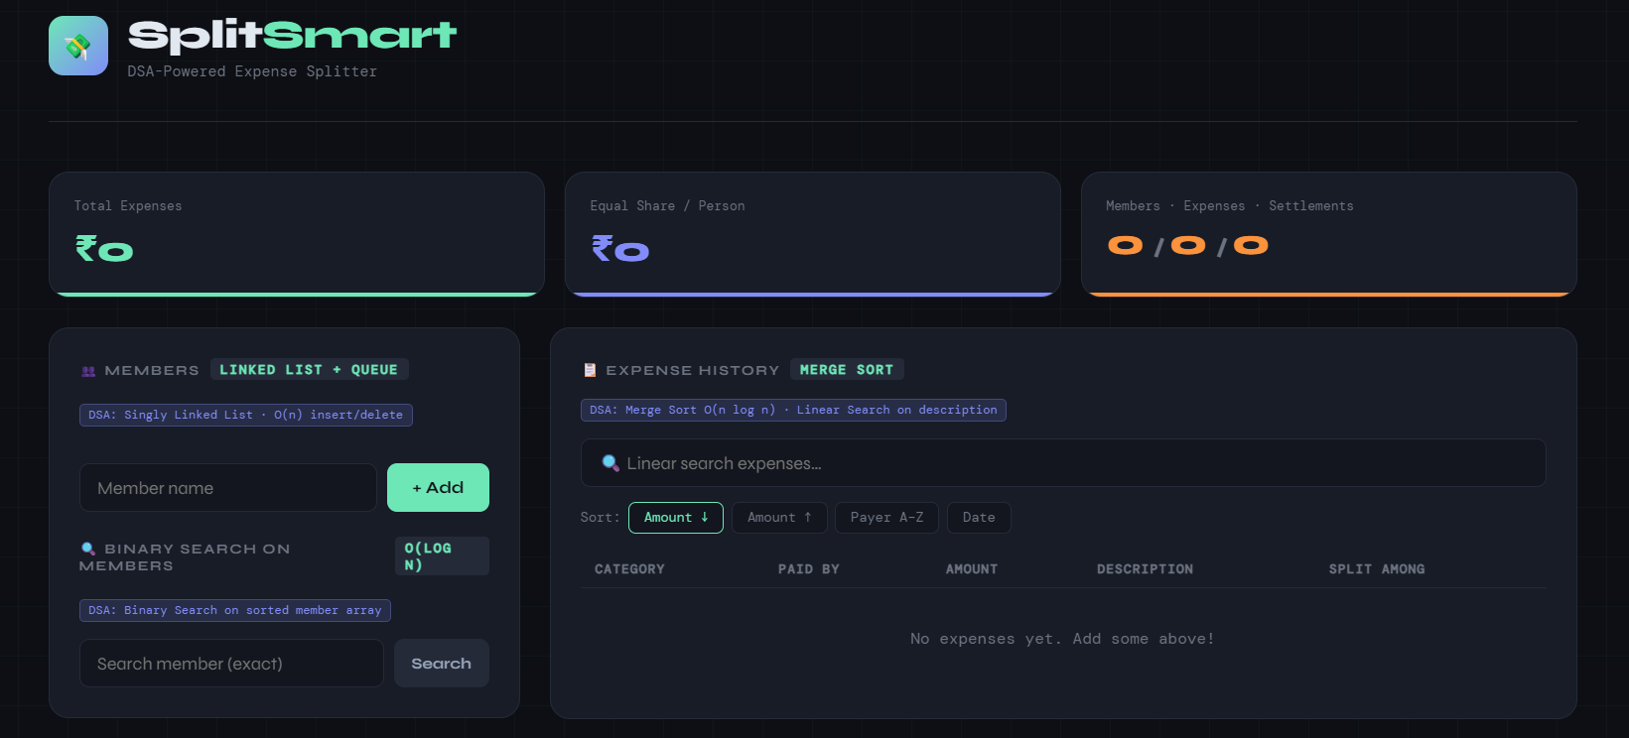
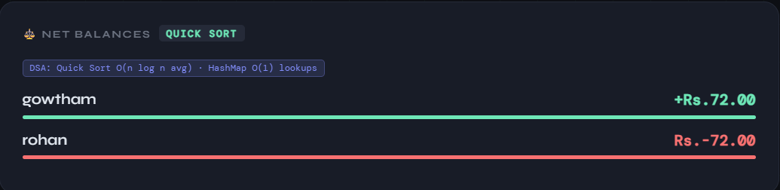
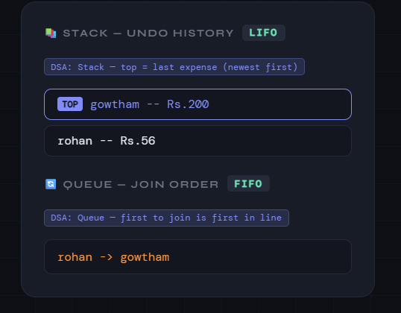
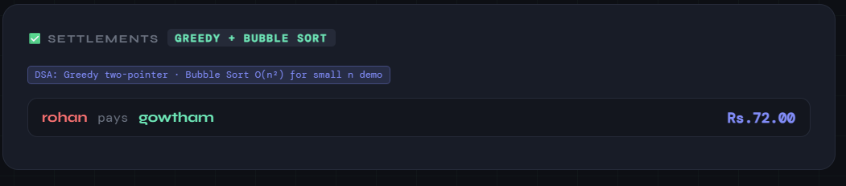
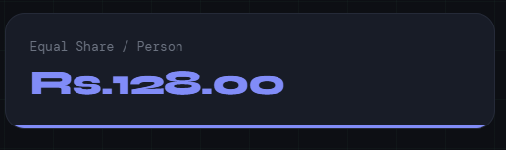
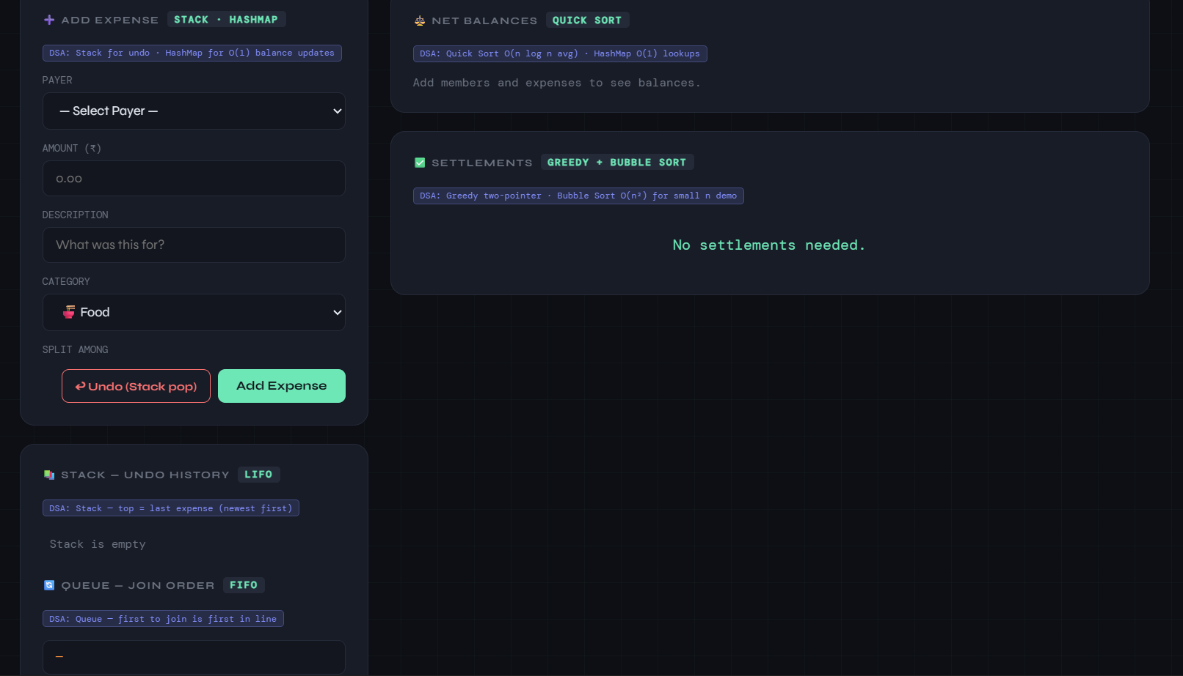
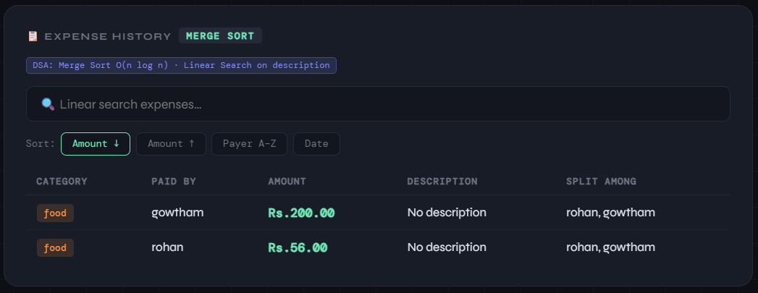
Screenshots for FWD & DSA

Slide 12
Conclusion
The Group Based Expense Sharing Tool successfully demonstrates the application of Front-End Web Development and Data Structures in a practical system. The project simplifies the management of shared expenses by providing an intuitive interface and automated calculations.
By implementing data structures such as arrays, stacks, queues, and algorithms like searching and sorting, the project highlights how theoretical concepts can be applied to real-world applications. The system improves accuracy, efficiency, and transparency in group expense management.

Slide 13
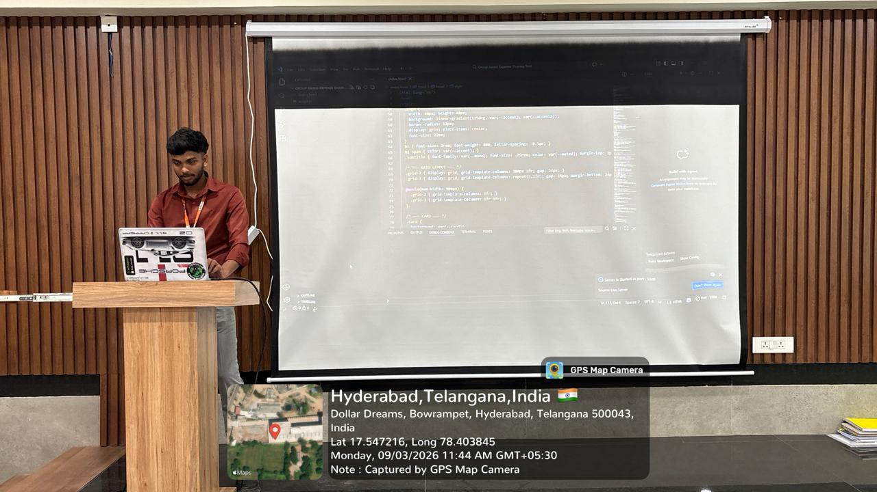
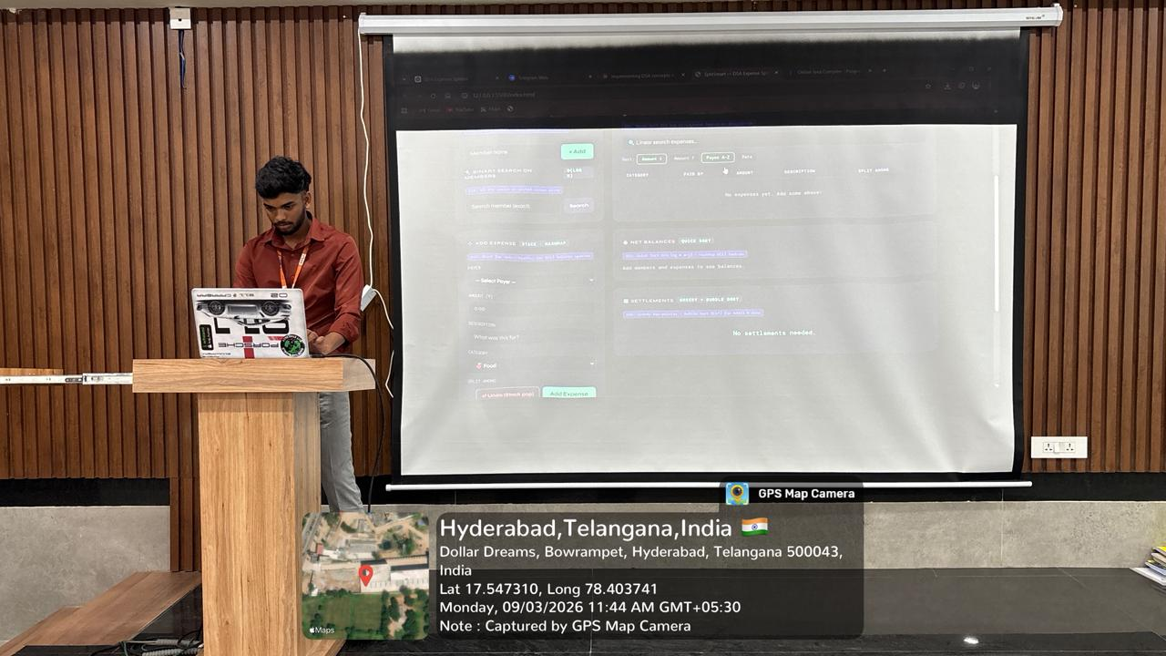
Geo- Tag Photos

Slide 14
THANK YOU

